Slide 1
ECG signal feature extraction trends in methods and applications
August 2024
Andrea Corrado

Slide 2
Background
Nowadays signal analysis, an amalgamation of different processes coming together to form robust pipelines for the automation of data analysis, is deeply applied into the medical world. In fact, even in this field it is becoming increasingly common to be working with very large datasets, on the scale of having thousands of features.
This is largely because the acquisition of biomedical signals can be taken over multi-hour timeframes, which is another challenge to solve in and of itself. This paper will focus on the electrocardiogram (ECG) signal specifically, and common feature extraction techniques used for digital health and artificial intelligence (AI) applications.
Feature extraction is a vital step of biomedical signal analysis. The basic goal is for signal dimensionality reduction and data compaction. This would allow one to represent data with a smaller and not redundant subset of features, that can be used later to build efficient ML models for several tasks such as classification, detection etc.
In this review, it has been covered ECG signal processing and feature extraction in the time domain, frequency domain, time–frequency domain, decomposition, and sparse domain. Furthermore, it has been discussed even deep features, and machine learning integration, to complete the overall pipeline design for signal analysis.

Slide 3
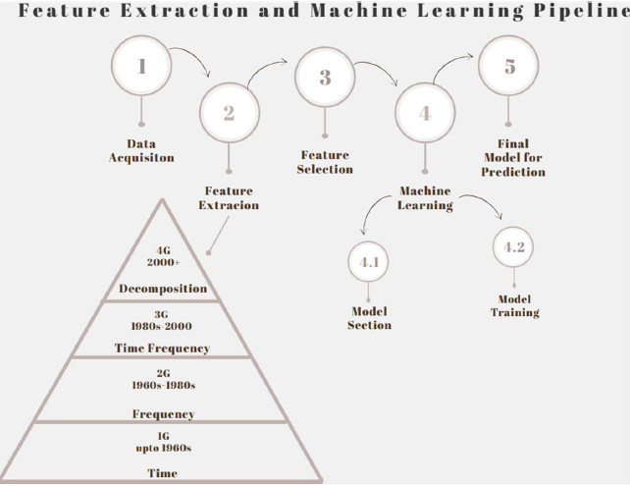
Why feature extraction
Biomedical signals are in general:
non-stationary,
non-linear,
non-Gaussian,
non-short form.
So, using a group of descriptors capable to capture the characteristics of these signals is crucial due to their complexity.
The goal is to reduce data dimensionality and improve efficiency for machine learning (ML) and artificial intelligence (AI) models, particularly for classification and diagnosis. Effective feature selection, following extraction, significantly impacts model performance.

Slide 4
Review structure and methods selection
Review structure
This review focus on these main feature selection fields
Time domain
Frequency/Spectral domain
Time–Frequency domain
Decomposition domain
Deep features
Each method is presented using even a pseudo code, which present the algorithm used into the study from which the method is taken.
Methods selection
Methods are chosen following these criteria:
Relevance of feature extraction technique
Application on ECG of algorithmic signal analysis pipeline
Digital/AI/Telehealth Biomedical Application
Year of publication
Language: English

Slide 5
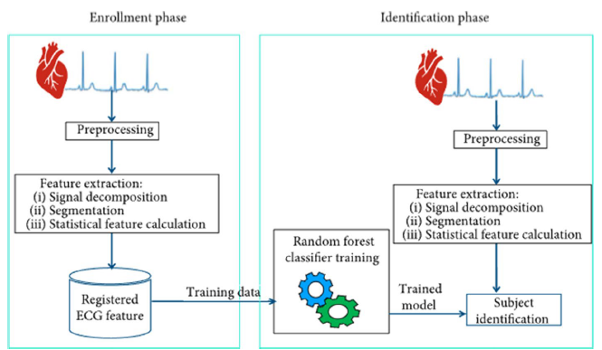
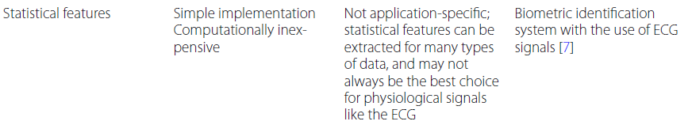
Time domain features
Some example of statistical descriptors:
Mean
Standard deviation
Median
Maximum value
Minimum value
Range
Interquartile range
Interquartile first quarter (Q1)
Interquartile third quarter (Q3)
Kurtosis
Skewness of ECG signal
Simple subject identification system based on statistical features

Slide 6
Time domain: statistical features
Some example of statistical descriptors:
Mean
Standard deviation
Median
Maximum value
Minimum value
Range
Interquartile range
Interquartile first quarter (Q1)
Interquartile third quarter (Q3)
Kurtosis
Skewness of ECG signal
Simple subject identification system based on statistical features

Slide 7
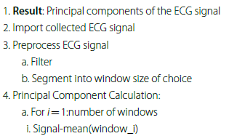
Time domain: PCA
The goal of this technique is to extract the “principal components” of the signal, which are derived as a linear combination of the variables of the data (i.e., time samples of the ECG), with weights to ensure the components are mutually uncorrelated.
Such technique is used to track temporal changes due to myocardial ischemia or signal separation during atrial fibrillation, just to name some applications.

Slide 8
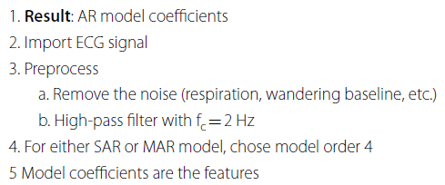
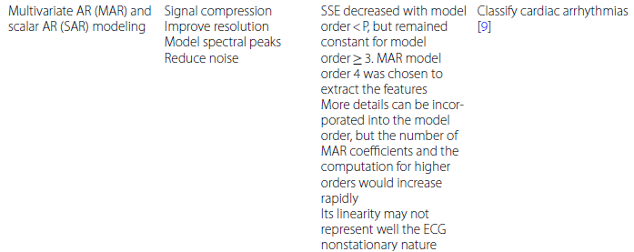
Time domain: MAR and SAR models
Background
The dataset used in the case study analysed was obtained from the MIT/BIH database, which included normal sinus rhythm (NSR), atria premature contraction (APC),premature ventricular contraction (PVC), ventricular tachycardia (VT), ventricular
fibrillation (VF) and supraventricular tachycardia (SVT). The NSR, PVC and APC were sampled at a frequency of 360 Hz. The VT/’VF signals were sampled at a frequency of 250 Hz. The SVT signals were sampled at a frequency of 128 Hz. The data was sampled such that all the two-lead ECG signals in the analysis had a frequency of 250 Hz.

Slide 9
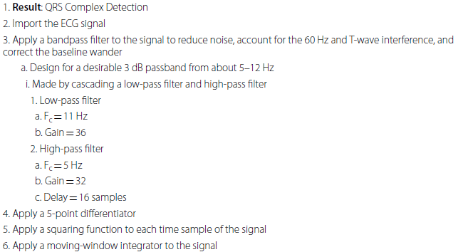
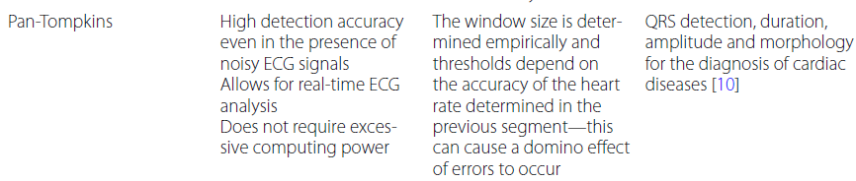
Time domain: Pam-Tompkins
Background
The dataset used in this study was from the MIT/BIH and AHA database and consisted of 48 half-hour recordings. This came together to form 24 h of ECG 2-channel data, including the annotation channel and binary-recorded timing track channel

Slide 10
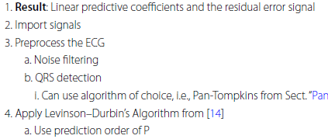
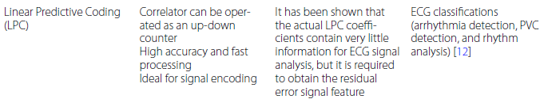
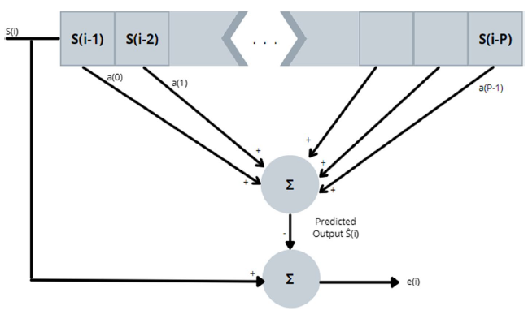
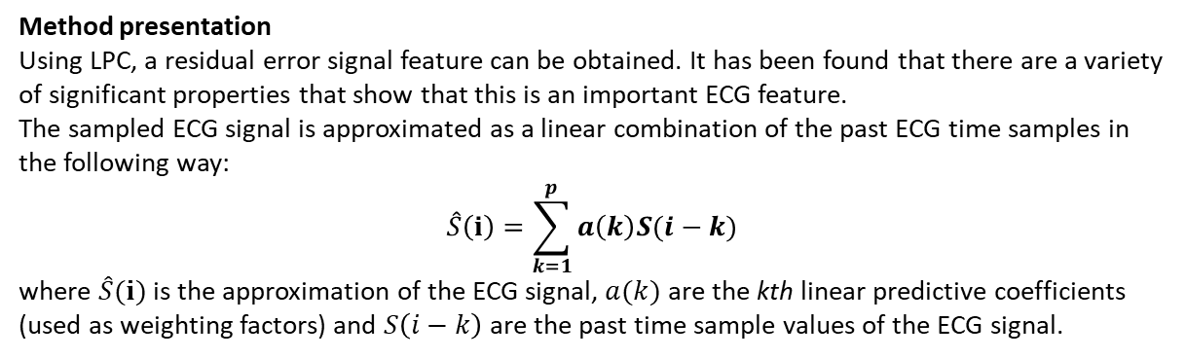
Time domain: Linear predictive coding
Method presentation
Using LPC, a residual error signal feature can be obtained. It has been found that there are a variety of significant properties that show that this is an important ECG feature.
The sampled ECG signal is approximated as a linear combination of the past ECG time samples in the following way:
$$\hat{S}\left(i\right)=\sum_{k=1}^{p}{a\left(k\right)S(i−k)}$$
where $\hat{S}(i)$ is the approximation of the ECG signal, $a(k)$ are the kth linear predictive coefficients (used as weighting factors) and $S\left(i−k\right)$are the past time sample values of the ECG signal.
Background
The dataset used for this study was taken from the MIT/BIH arrhythmia database. The sampling rate was 360 Hz. There were annotation files available for comparison to the algorithm-detected PVCs.

Slide 11
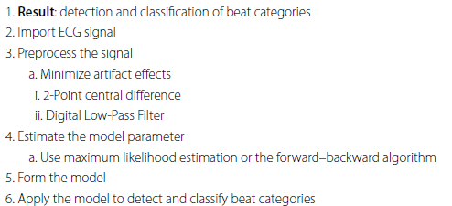
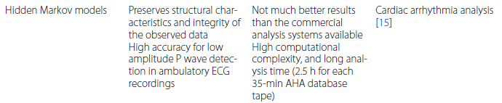
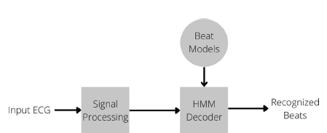
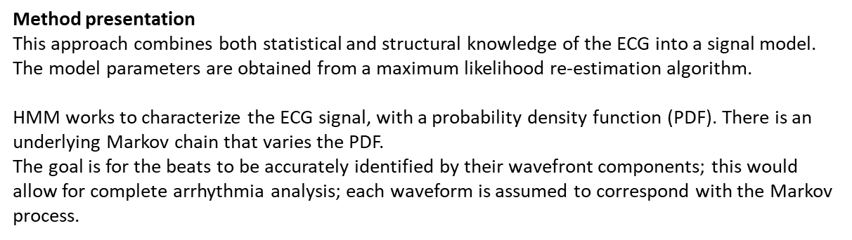
Time domain: Hidden Markov Models
Method presentation
This approach combines both statistical and structural knowledge of the ECG into a signal model. The model parameters are obtained from a maximum likelihood re-estimation algorithm.
HMM works to characterize the ECG signal, with a probability density function (PDF). There is an underlying Markov chain that varies the PDF.
The goal is for the beats to be accurately identified by their wavefront components; this would allow for complete arrhythmia analysis; each waveform is assumed to correspond with the Markov process.
Background
The database used was from the American Heart Association (AHA) ventricular arrhythmia database. It consists of 80 1/2-h 2-channel ECG recordings which have been sampled at a frequency of 250 Hz.

Slide 12
Time domain: Hidden Markov Models
Method presentation
This approach combines both statistical and structural knowledge of the ECG into a signal model. The model parameters are obtained from a maximum likelihood re-estimation algorithm.
HMM works to characterize the ECG signal, with a probability density function (PDF). There is an underlying Markov chain that varies the PDF.
The goal is for the beats to be accurately identified by their wavefront components; this would allow for complete arrhythmia analysis; each waveform is assumed to correspond with the Markov process.
Background
The database used was from the American Heart Association (AHA) ventricular arrhythmia database. It consists of 80 1/2-h 2-channel ECG recordings which have been sampled at a frequency of 250 Hz.

Slide 13
Time domain: Hidden Markov Models
Method presentation
This approach combines both statistical and structural knowledge of the ECG into a signal model. The model parameters are obtained from a maximum likelihood re-estimation algorithm.
HMM works to characterize the ECG signal, with a probability density function (PDF). There is an underlying Markov chain that varies the PDF.
The goal is for the beats to be accurately identified by their wavefront components; this would allow for complete arrhythmia analysis; each waveform is assumed to correspond with the Markov process.
Background
The database used was from the American Heart Association (AHA) ventricular arrhythmia database. It consists of 80 1/2-h 2-channel ECG recordings which have been sampled at a frequency of 250 Hz.

Slide 14
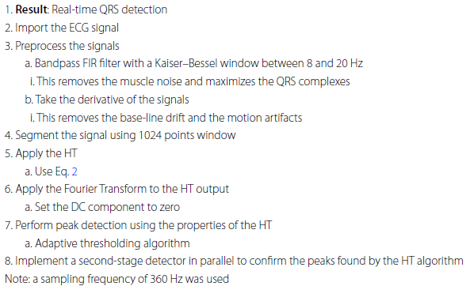

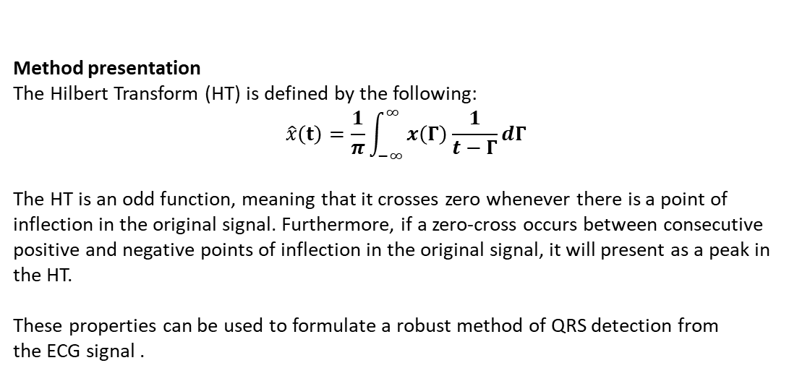
Frequency domain: Hilbert transform
Method presentation
The Hilbert Transform (HT) is defined by the following:
$$\hat{x}\left(t\right)=\frac{1}{π}\int_{−∞}^{∞}{x\left(Γ\right)\frac{1}{t−Γ}dΓ}$$
The HT is an odd function, meaning that it crosses zero whenever there is a point of inflection in the original signal. Furthermore, if a zero-cross occurs between consecutive positive and negative points of inflection in the original signal, it will present as a peak in the HT.
These properties can be used to formulate a robust method of QRS detection from
the ECG signal .
Background
The dataset used in this study was from the MIT/BIH arrhythmia database. The database consisted of ECG signals recording from the modified limb lead II, as well as the modified leads V5 and V1.

Slide 15

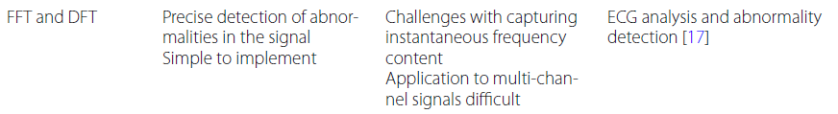
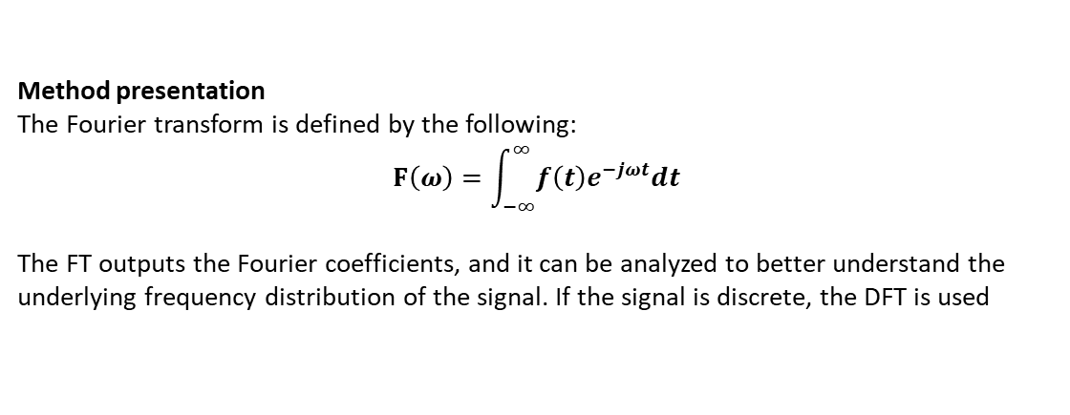
Frequency domain: Fourier transform
Method presentation
The Fourier transform is defined by the following:
$$F\left(ω\right)=\int_{−∞}^{∞}{f\left(t\right)e^{−jωt}dt}$$
The FT outputs the Fourier coefficients, and it can be analyzed to better understand the underlying frequency distribution of the signal. If the signal is discrete, the DFT is used

Slide 16
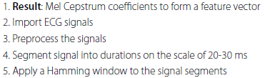


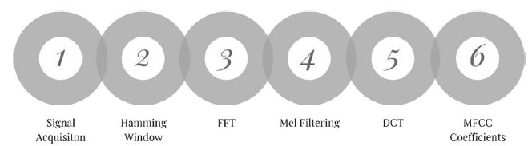
Frequency domain: MFCC Algorithm
Method presentation
The MFCC is a linear representation of the cosine transforms of a short duration of logarithmic power spectrum of the ECG signal.
Background
The dataset in this case study was obtained from the MIT/BIH arrhythmia database. The records are 30 min long per patient, and contain both normal and abnormal ECG signals.

Slide 17
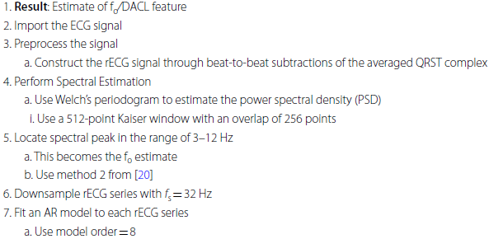
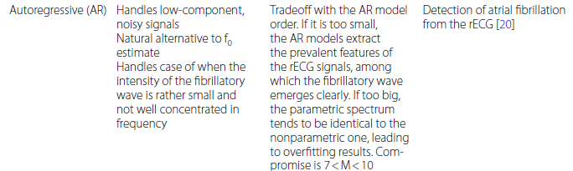
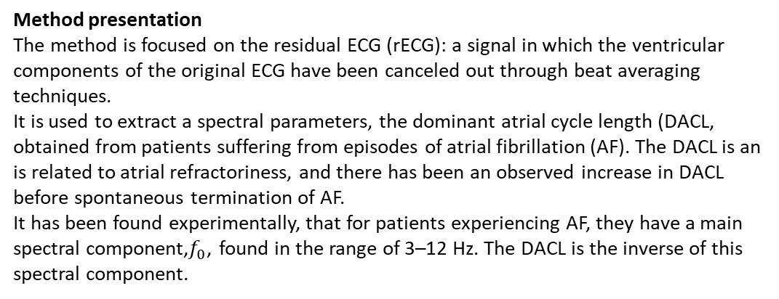
Frequency domain: AR in frequency domain
Method presentation
The method is focused on the residual ECG (rECG): a signal in which the ventricular components of the original ECG have been canceled out through beat averaging techniques.
It is used to extract a spectral parameters, the dominant atrial cycle length (DACL, obtained from patients suffering from episodes of atrial fibrillation (AF). The DACL is an is related to atrial refractoriness, and there has been an observed increase in DACL before spontaneous termination of AF.
It has been found experimentally, that for patients experiencing AF, they have a main spectral component,$f_{0}$, found in the range of 3–12 Hz. The DACL is the inverse of this spectral component.
Background
The dataset in this study was taken from Physionet’s Spontaneous termination AF database. The rECGs were constructed for each of the recordings in the database.
There is a collection of 80 two-channel ECG signals in the database, each being a recording of AF for a duration of 60 s. They have been sampled at a frequency of 128 Hz

Slide 18
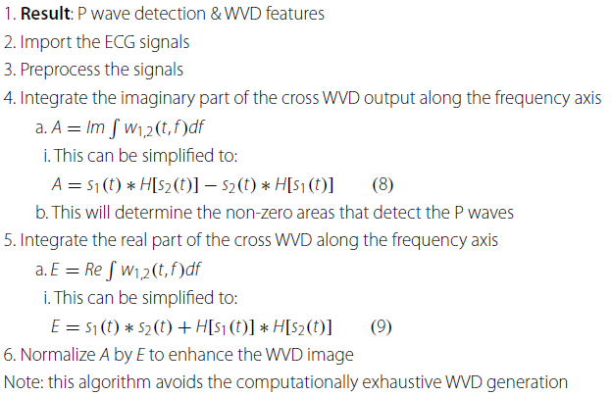
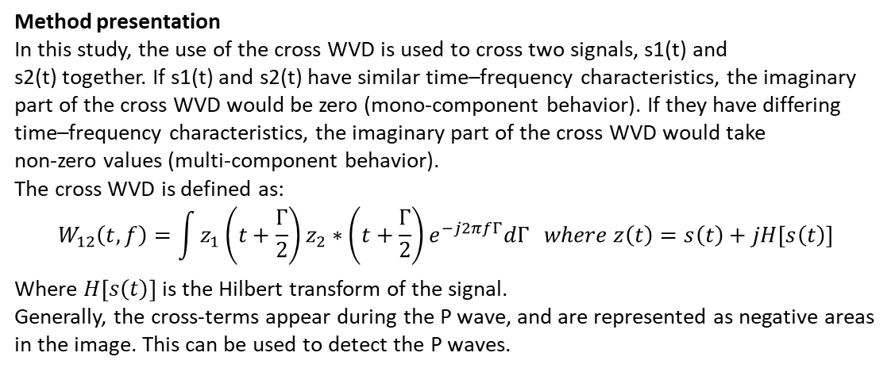
Time- Frequency domain: Wigner–Ville distribution (WVD)
Method presentation
In this study, the use of the cross WVD is used to cross two signals, s1(t) and
s2(t) together. If s1(t) and s2(t) have similar time–frequency characteristics, the imaginary
part of the cross WVD would be zero (mono-component behavior). If they have differing
time–frequency characteristics, the imaginary part of the cross WVD would take
non-zero values (multi-component behavior).
The cross WVD is defined as:
$$W_{12}\left(t,f\right)=\int{z_{1}\left(t+\frac{Γ}{2}\right)z_{2}∗\left(t+\frac{Γ}{2}\right)e^{−j2πfΓ}dΓ} where z\left(t\right)=s\left(t\right)+jH\left[s\left(t\right)\right]$$
Where $H\left[s\left(t\right)\right]$ is the Hilbert transform of the signal.
Generally, the cross-terms appear during the P wave, and are represented as negative areas in the image. This can be used to detect the P waves.
Background
The dataset used in this study was taken from the MIT/BIH database

Slide 19
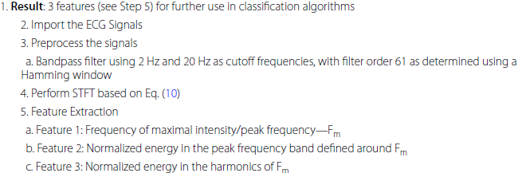
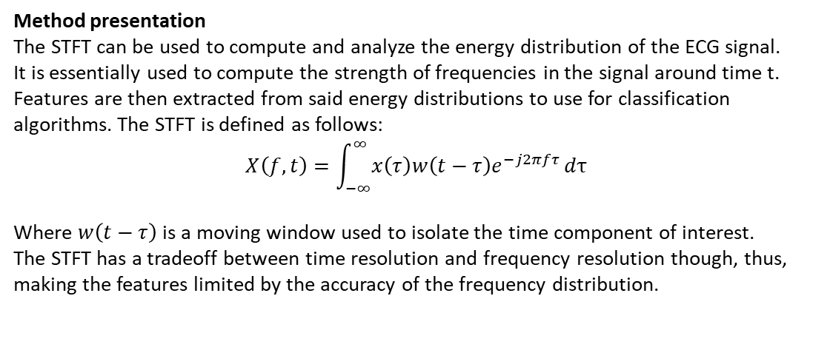
Time- Frequency domain: Short-time Fourier transform
Method presentation
The STFT can be used to compute and analyze the energy distribution of the ECG signal.
It is essentially used to compute the strength of frequencies in the signal around time t. Features are then extracted from said energy distributions to use for classification
algorithms. The STFT is defined as follows:
$$X\left(f,t\right)=\int_{−∞}^{∞}{x\left(τ\right)w\left(t−τ\right)e^{−j2πfτ}}dτ$$
Where $w\left(t−τ\right)$ is a moving window used to isolate the time component of interest.
The STFT has a tradeoff between time resolution and frequency resolution though, thus, making the features limited by the accuracy of the frequency distribution.
Background
The ECG dataset used in this study was taken from the Staley cardiac arrhythmia database, from which the raw data was collected by the Wisconsin-Dane County EMT-defibrillation program. It includes recordings of ventricular fibrillation, asystole, and more. The signals were acquired at a sampling rate of 100 Hz. Normal rhythms were taken from the MIT/BIH database, which are sampled at 360 Hz

Slide 20
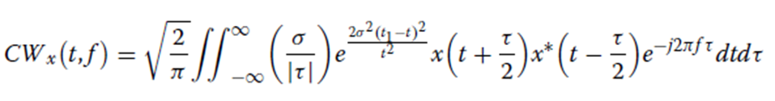

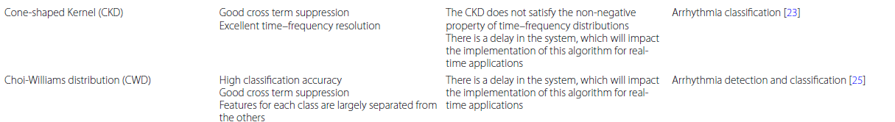
Time- Frequency domain: improving cross terms
Need of cross terms improvement
Both WVD and STFT are affected by the presence of cross terms, as result of the windowing made on signals. To reduce them, more accurate methods can be used:
Choi-Williams distribution:
Cone-shaped method
Both works by using a kernel function which reduce cross terms and improve the overall time-frequency distribution. In both cases the algorithm is pretty similar to the proposed one, except obliviously from the transformation used.

Slide 21
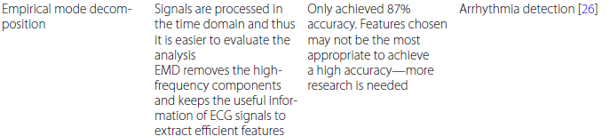
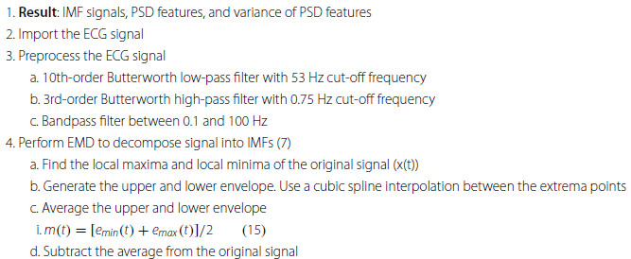
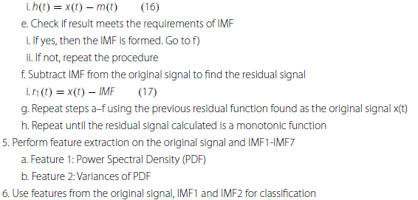
Decomposition domain: Empirical Mode Decomposition
Method presentation
The empirical mode decomposition (EMD) method allows for the ECG signal to be
split into levels of intrinsic mode functions (IMFs), correlated to the frequency distribution
in the signal (from lower to higher frequencies). IMFs are created through an interactive procedure called “sifting.” Certain requirements must be met for an IMF to truly be an IMF:
The count of local extrema, as well as the count of zero crossings, must be equal to each other or different by at most one.
The average of the envelope (defined by the local maxima and local minima) calculated in the EMD algorithm should be zero at any time point.
Background
The dataset used in this study was taken from the MIT/BIH arrhythmia database, and it consisted of signals that were classified as the following: normal, left, and right bundle branch blocks, premature ventricular contraction, paced beat, and atrial premature beats. 27 records were selected, and each record contained 2-channel ECG signals, with a duration of 30 min each. A sampling rate of 360 Hz was used, and the signals were bandpass filtered between 0.1 and 100 Hz

Slide 22
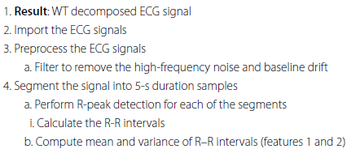
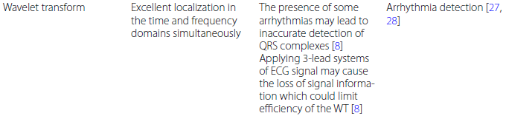
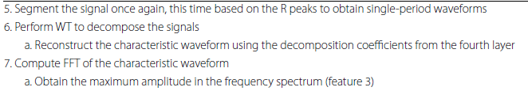
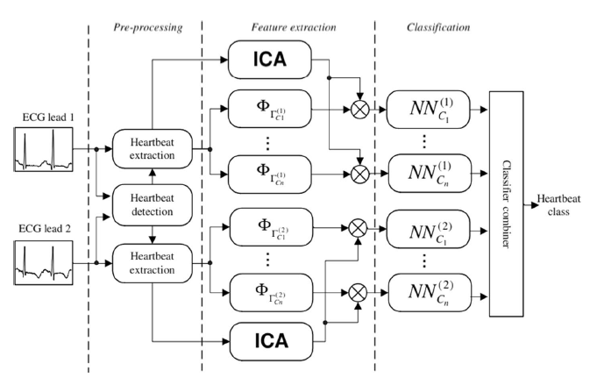
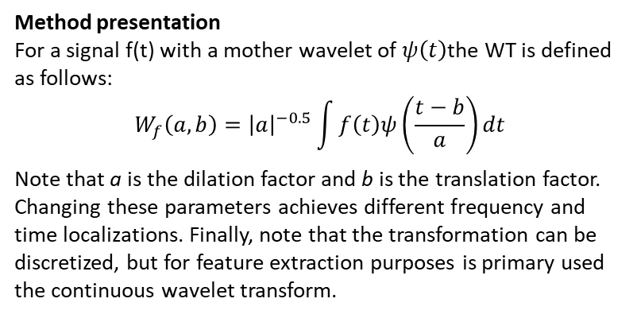
Decomposition domain: Wavelet transform algorithm
Method presentation
For a signal f(t) with a mother wavelet of $ψ\left(t\right)$the WT is defined as follows:
$$W_{f}\left(a,b\right)={\left|a\right|}^{−0.5}\int{f\left(t\right)ψ\left(\frac{t−b}{a}\right)dt}$$
Note that a is the dilation factor and b is the translation factor. Changing these parameters achieves different frequency and time localizations. Finally, note that the transformation can be discretized, but for feature extraction purposes is primary used the continuous wavelet transform.
Method improvements
Wavelet decomposition can be used coupled with ICA analysis to make the feature extraction even more robust, adding the information about the independency of the components.
Background
The dataset used in the studies examined for the wavelet transform used the MIT/ BIH database.

Slide 23
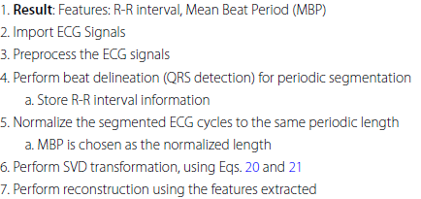
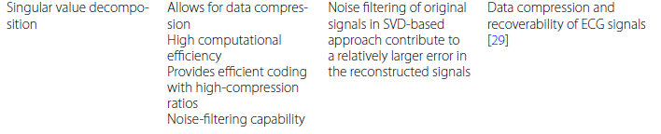
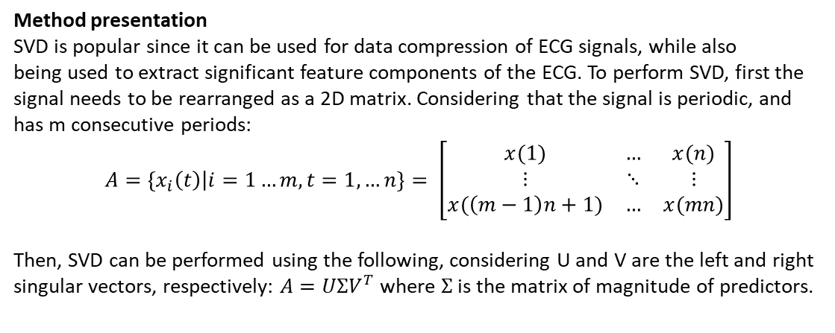
Decomposition domain: Singular Value Decomposition
Method presentation
SVD is popular since it can be used for data compression of ECG signals, while also
being used to extract significant feature components of the ECG. To perform SVD, first the signal needs to be rearranged as a 2D matrix. Considering that the signal is periodic, and has m consecutive periods:
$$A=\left\{x_{i}\left(t\right)\right|i=1…m, t=1,…n\}= \left[\begin{matrix}x(1) & … & x(n) \\ ⋮ & ⋱ & ⋮ \\ x(\left(m−1\right)n+1) & … & x(mn)\end{matrix}\right]$$
Then, SVD can be performed using the following, considering U and V are the left and right singular vectors, respectively: $A=UΣV^{T}$ where $Σ$ is the matrix of magnitude of predictors.
Background
The dataset used in this study was taken from the 48 two-lead ECG recordings available in the MIT/BIH database. Each recording is 30 min in duration and the sampling frequency is 360 Hz.

Slide 24
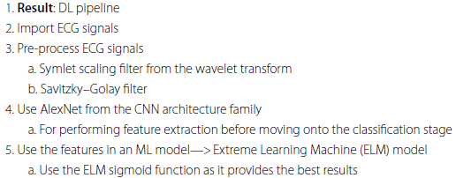
Deep Learning
Deep learning (DL), a subset of machine learning (ML) which employs neural networks with some layers to simulate human reasoning.
Unlike ML, DL efficiently processes unstructured data without extensive preprocessing or human expert input, automatically detecting the most useful features for classification.
Various deep neural networks, including convolutional neural networks (CNNs) and recurrent neural networks (RNNs), are chosen based on the application. DL has significant applications in healthcare; for instance, CNNs are used to classify heart disorders from ECG data.
Although DL is designed to handle raw data, some preprocessing, such as filtering, may still be performed to enhance results.

Slide 25
Conclusions
In this article are reviewed various feature extraction methods: time domain, frequency domain, time–frequency domain, and decomposition domain and can be observed that increasing signal data dimensions improve signal representation:
Time domain and frequency domain features are straightforward but insufficient for optimal signal representation. Popular methods in time domain (e.g., LPC) and frequency domain (e.g., FFT) have limitations like computational complexity and noise sensitivity.
Time–frequency domain methods perform better for ECG due to non-linear and non-stationary characteristics. They combines insights from both time and frequency domains, offering better signal representation but with trade-offs in resolution and computational cost. Generally, provide the best ECG signal representation.
Decomposition domain allows for signal decomposition, removing irrelevant components, aiding in data compression and preprocessing. Methods in decomposition domain (e.g., EMD, WT) have drawbacks like information loss and high computational power.
Features can be integrated into ML pipelines for various applications, but practical feature extraction should generate robust features, reduce dimensionality, and integrate easily with ML models.

